Slide 1
SpectroGAN: Emotion transfer on spectrogram of speech
EE599 Deep Learning - Project Presentation
ASHWIN TELAGIMATHADA RAVI
KARKALA SHASHANK HEGDE
VINEETH RAJESH ELLORE

Slide 2
Overview
We have implemented a Cycle GAN to transfer various emotions in speech using spectrograms.
We have optimized our Cycle GAN using different number of ResNet blocks in the generator and FFT lengths of the audio clip.
We have tested the effectiveness of our cycle GAN model on different speakers and languages.
Project link: https://hegde95.github.io/GAN-for-speech-spectrogram/

Slide 3
Literature Survey
Cycle GAN has produced optimal results for style transfer applications.[1]
Emotion transfer on speech has been implemented using MLP.[2]
Traditional methods used hand-engineered features (pitch, energy, zero-crossings, MFCC) for emotion analysis in audio.[3]
Modern deep learning methods have used automated feature extraction and have shown promising results.[4][5]
We have implemented emotion transfer on spectrogram images using a Cycle GAN.

Slide 4
Dataset Description
We have used The Ryerson Audio-Visual Database of Emotional Speech and Song (RAVDESS) dataset.
24 professional actors (12 female, 12 male), vocalizing two lexically-matched statements in a neutral North American accent.
3 seconds long, 16bit, 48kHz .wav files.
Emotions available are anger, calm, disgust, fearful, happy, neutral, sad and surprised.
Source: https://zenodo.org/record/1188976#.XrELfqhKjIV

Slide 5
Cycle GANs for image-to-image translation
The Cycle GAN does NOT require a dataset of paired images
Image source: https://www.youtube.com/watch?v=9N_uOIPghuo

Slide 6
Cycle GAN Generator Model
Six Resnet blocks
Model consists of down-sampling convolutional blocks, six Resnet blocks and up-sampling convolutional blocks.

Slide 7
Cycle(Patch) GAN Discriminator Model
C64 C128 C256 C512
Discriminator model maps the entire input image into 70×70 individual patches to real or fake.
Predictions are averaged to give the final output of the model

Slide 8
Cycle GAN Composite Model
Composite model is required for each generator model for updating weights of that generator model only.
An update to each generator model involves minimizing:
Adversarial loss (L2 or mean squared error).
Identity loss (L1 or mean absolute error).
Forward cycle loss (L1 or mean absolute error).
Backward cycle loss (L1 or mean absolute error).
The weights are then shared with the related discriminator and the other generator.

Slide 9
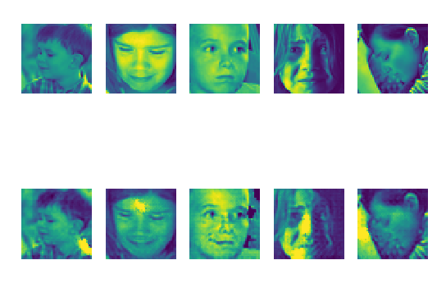
Emotion Transfer On Facial Images
Sad to happy face conversion after 50 epochs
Dataset Source: https://www.kaggle.com/c/challenges-in-representation-learning-facial-expression-recognition-challenge/data

Slide 10
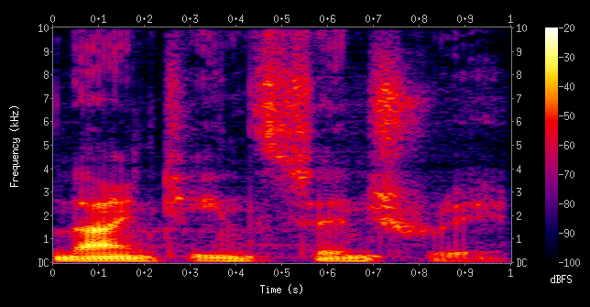
What are Spectrograms?
Visual representation of the spectrum of frequencies as it varies with time.
Image source: https://en.wikipedia.org/wiki/Spectrogram

Slide 11
Data Conversion
Speech to Spectrogram
Sampled at 16000 Hz, performed STFT with
FFT length of 512 and hop length of 256.
FFT length of 1024 and hop length of 128.
Obtained spectrograms(by padding zeros) of
260x260 pixels
520x520 pixels
Spectrogram to Speech
Used Griffin Lim algorithm with corresponding FFT Length to get back speech

Slide 12
DEMO and RESULTS

Slide 13

Emotion Transfer on Speech Spectrogram
Number of Resnet Blocks | Original Audio (Neutral) | Converted Audio (Angry)
3
6
9
We found that six Resnet Blocks gave good conversion while maintaining model complexity.
We decided to test conversion for distinct emotions

Slide 14
Testing on 260x260 Spectrograms
Emotion | Original Audio | Converted Audio
Calm to Fearful
Calm to Angry
Happy to Sad
Calm
Fearful
Happy
Sad
Calm to Fearful and Calm to Angry conversion gave good results after 100 epochs

Slide 15
Testing on 520x520 Spectrograms
Emotion | Original Audio | Converted Audio
Calm to Fearful
Calm to Angry
Calm
Anger
After 100 epochs, we found that 260x260 images perform better.

Slide 16

Testing Model Effectiveness
Data Type | Original Audio | Converted Audio
 | Calm | Fearful | Angry
Unseen Audio from RAVDESS
Different audio from unseen speakers
Different Language Audio
Kannada
Hindi
Model is able to generate speech on unseen script, languages and speakers.

Slide 17
Conclusion
Optimal model consists of six ResNet blocks(in generator) and 260x260 input image size.
This method can be used to train a versatile Cycle GAN on lexically limited data content.

Slide 18
Future Work
Train 260x260 resolution GAN model for more epochs.
Train for more emotion pairs.
De-noising of generated audio to get better results.
Include IEMOCAP dataset for future training.

Slide 19
References
[1] Jun-Yan et al. Unpaired Image-to-Image Translation using Cycle-Consistent Adversarial Networks (2017) https://arxiv.org/abs/1703.10593
[2] Gao, Jian et al. “Nonparallel Emotional Speech Conversion.” Interspeech 2019 (2019): n. pag. Crossref. Web. https://arxiv.org/abs/1811.01174
[3] Felix Burkhardt and Nick Campbell, "Emotional Speech Synthesis https://people.ict.usc.edu/~gratch/CSCI534/Readings/ACII-Handbook-SpeechSyn.pdf
[4] Satt et al. (2017) "Efficient Emotion Recognition from Speech Using Deep Learning on Spectrograms https://pdfs.semanticscholar.org/de47/fc09bc8dcd032c8b3450a0b2a816c376e07e.pdf
[5] Wyse et al. "Audio Spectrogram Representations for Processing with Convolutional Neural Networks" (2017) https://arxiv.org/abs/1706.09559
[6] Oyamada et al. "Generative adversarial network-based approach to signal reconstruction from magnitude spectrograms" (2018) https://arxiv.org/abs/1804.02181
[7] M. Stolar, M. Lech, R. S. Bolia and M. Skinner, "Acoustic Characteristics of Emotional Speech Using Spectrogram Image Classification," 2018 12th International Conference on Signal Processing and Communication Systems (ICSPCS), Cairns, Australia, 2018, pp. 1-5, doi: 10.1109/ICSPCS.2018.8631752. https://ieeexplore.ieee.org/document/8631752

